Slide 1
Plagiarism
Citation and refences

Slide 2
What is plagiarism?
Plagiarism means using someone else’s work without giving them proper credit. In academic writing, plagiarizing involves using words, ideas, or information from a source without citing it correctly.
Plagiarism can occur in many different contexts. While often associated with school assignments, it can also happen in professional settings, such as the arts, academia, and the business world.
Let’s know more about plagiarism.

Slide 3

What is plagiarism?

Slide 4
Types of plagiarism
Plagiarism can involve copying words or images directly, paraphrasing sentences or passages, or co-opting someone else’s ideas without citing the original work.
In academic writing, there are various types of plagiarism you might encounter:
Global plagiarism means plagiarizing an entire text. This includes purchasing an essay or turning in an assignment completed by someone else.
Patchwork or mosaic plagiarism means copying phrases, passages, and ideas from different sources and compiling them into a new text.
Incremental plagiarism means inserting a small amount of plagiarized content in a mostly original text.
Self-plagiarism means recycling your own previous work that you’ve already submitted or published.

Slide 5
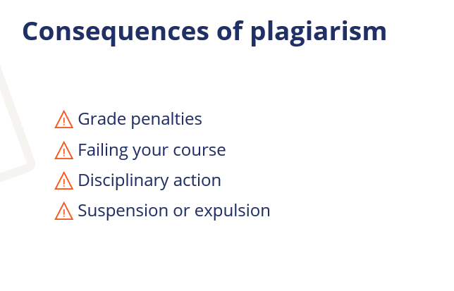

Slide 6
How to avoid plagiarism
3 steps to follow
Notes:
To avoid plagiarism, follow these 3 steps while preparing and writing your academic assignments.
“How to Avoid Plagiarism with 3 Simple Tricks” video: https://youtu.be/uQhVDH9p7aU

Slide 7
Step 1: Keep track of your sources
KEEP A LIST OF ALL THE SOURCES YOU CONSULT
SOURCES INCLUDE WEBSITES, VIDEOS, MAGAZINES, ETC.
NOTE DOWN SOURCES JUST IN CASE, EVEN IF YOU’RE NOT SURE YOU’LL USE THEM
Notes:
The first step is to keep track of your sources as you do your research.
Note down details of every source you look at, even if you’re not sure whether you’ll use it in your paper.
Not only books and journal articles are sources; you should also keep track of any websites and multimedia sources you consult while doing your research. That includes things like YouTube videos, podcasts, images, and even social media posts.
Audience question: What kind of information about your sources might be important to write down?

Slide 8
Details to write down
Author name
Source title
Publication date
Publisher
Page numbers of specific quotes or passages
URL or DOI for online sources
Access date for online sources
Notes:
Important details to note down include the name of the author, the title of the source, the publication date, and the publisher.
If you find specific quotes or pieces of information you might want to use, write down the page numbers.
For online sources, keep a note of the URL of the source, or the DOI if there is one available (e.g. for a journal article).
It’s also important to write down when you accessed an online source, in case it changes over time.

Slide 9
Step 2: Quote or paraphrase
Two ways of sharing information from a source:
Quoting | Paraphrasing
Copy the author’s exact words Use quotation marks | Put the text into your own words No quotation marks
Notes:
The second step is to incorporate information from your sources into your text as you write.
Quoting and paraphrasing are two ways you can use a source without plagiarizing.
You can use quotes and paraphrases to share information and ideas from your sources, to provide evidence for your arguments, and to comment on the work of other researchers.

Slide 10
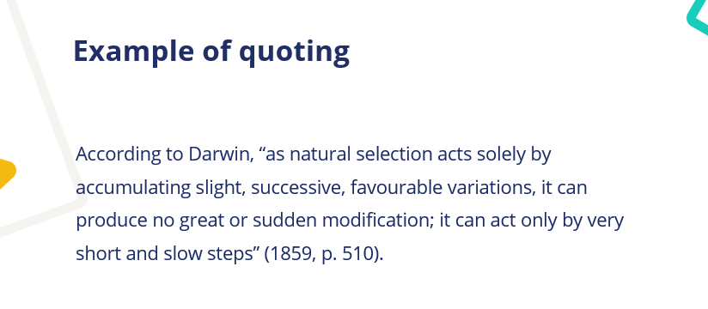
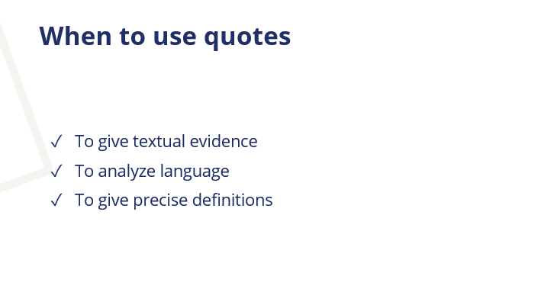

Slide 11
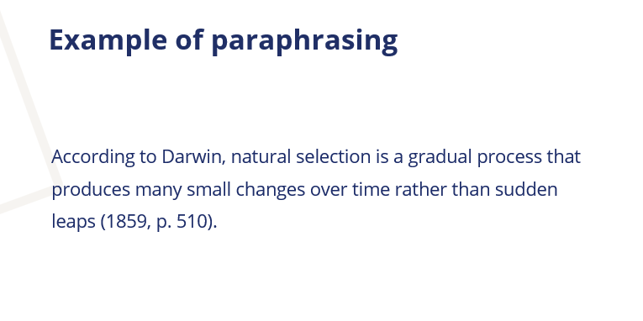
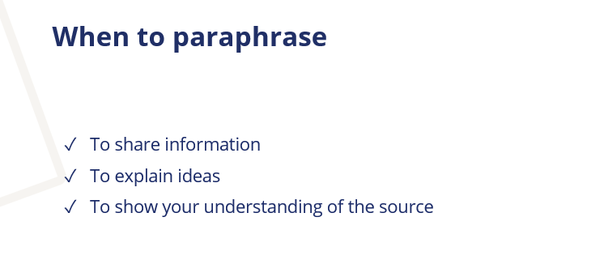

Slide 12
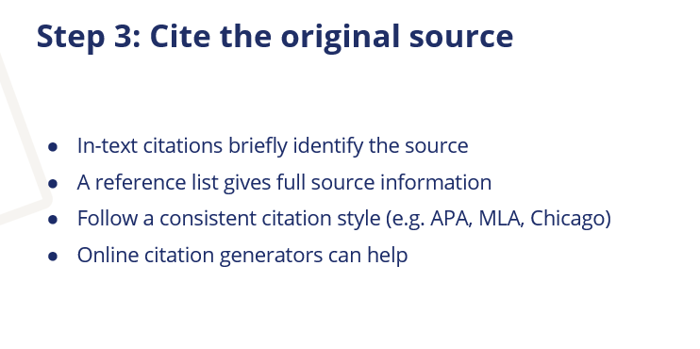

Slide 13
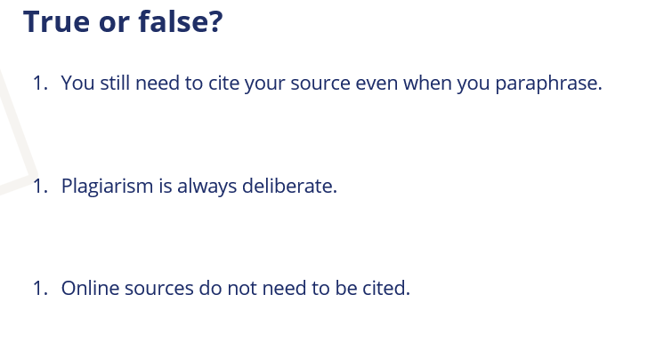

Slide 14
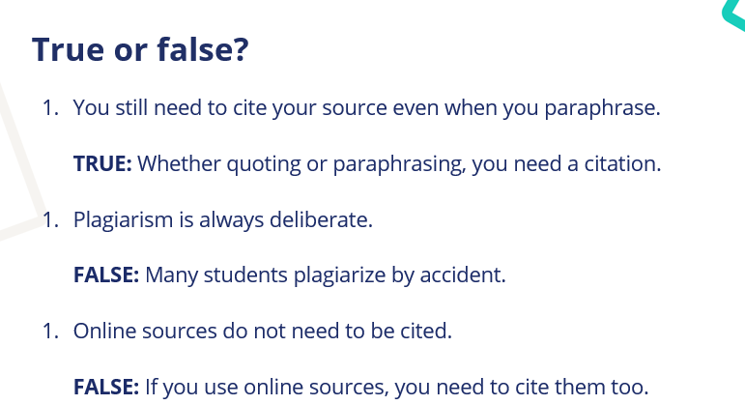

Slide 15
How to cite a quote in APA, MLA and Chicago
Every time you quote, you must cite the source correctly. This looks slightly different depending on the citation style you’re using. Three of the most common styles are APA, MLA, and Chicago.

Slide 16
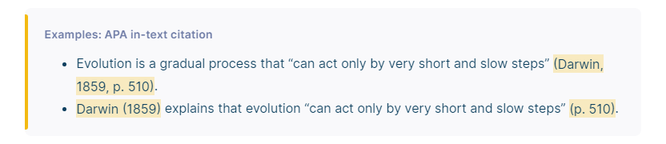
Apa Style
APA Style (American Psychological Association) is widely used by students, researchers, and professionals in the social and behavioral sciences.

Slide 17
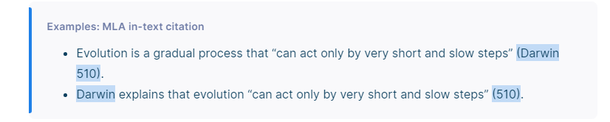
MLA style
MLA (Modern Language Association) style citations are commonly used by students and academics in the humanities.

Slide 18
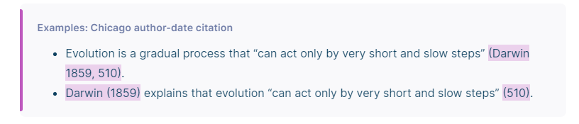
Chicago Style
The notes and bibliography system is preferred by many working in the humanities—including literature, history, and the arts.

Slide 19
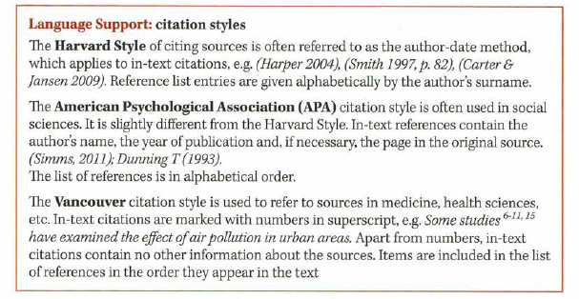

Slide 20
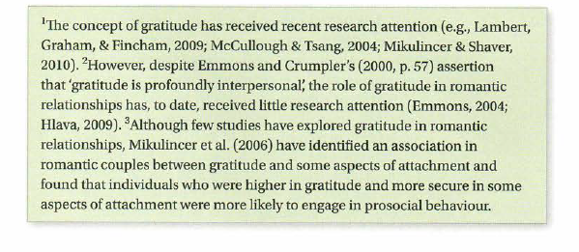
Task 1. Say which citation styles are used in Text

Slide 21
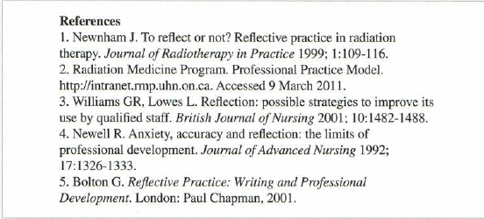
Task 2. Read extracts from reference lists from two articles and write down
the different types of sources they contain, e.g. a journal article, and the order in which
information is given in the reference. Discuss the differences in style.

Slide 22
